Slide 1

PBR ASSET PIPELINE
A 3D Pipline Overview for Physically Bade Rendering in Unreal Engine 4

Slide 2
Giving Credit where credit is due
I used the following resources to put together this slide share. A lot of it is cut and pasted or I worded description similarily added clarification where I thought I needed to explain more.
https://docs.unrealengine.com/latest/INT/Engine/Rendering/Materials/PhysicallyBased/
http://www.marmoset.co/toolbag/learn/pbr-practice
http://www.marmoset.co/toolbag/learn/pbr-theory
http://wiki.polycount.com/wiki/PBR

Slide 3
Discussion Overview
What is PBR and why does it change everything about texturing?
Misconceptions and Myths
What PBR Pipline does UE4 use?
Texture Maps Involved in an asset pipeline
Overview of High Polygon to Low Polygon Workflow
Modeling the High Resolution Model
Modeling the Low Resolution Model (Game Model)
UV Mapping and why it is important for Substance Painter
Texture baking your maps from High to Low in Knald
Using Substance Painter to paint your model with baked supporting textures
Visualizing your model in supporting 3rd Party Programs
Moving your Final Asset into Unreal Engine 4

Slide 4
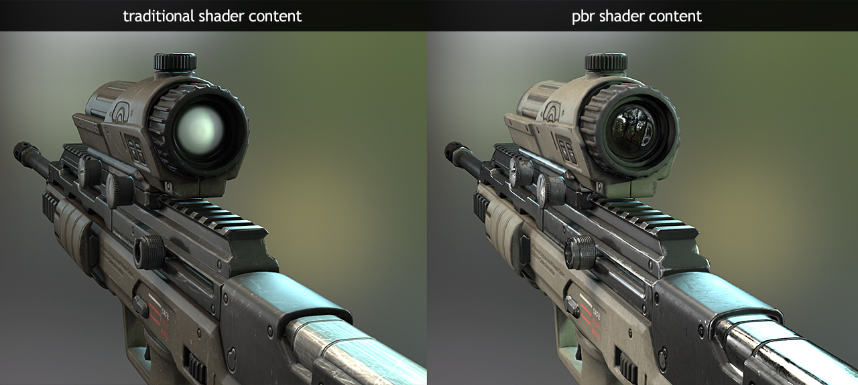
What is PBR and why does it change everything?
Physically based shading means we approximate what light actually does in the real world as opposed to approximating what we intuitively think it should do in past game engines.
The end result is a more accurate and typically more natural looking scene.
Image courtesy of www.marmoset.co

Slide 5
Image courtesy of www.marmoset.co

Slide 6
Myths and Misconceptions
PBR in the most basic sense is a combination of sophisticated shaders that represent the physics of light and matter, along with art content that is calibrated using plausible values to represent real world materials. PBR is essentially a holistic system of content creation and rendering, which can and often does have variances (generally shader models or texture input types) in actual implementation, depending on what tools or engine you use.
Additionally, loading any old content into a PBR shader does not guarantee physically accurate results. I see this misconception rearing its head equally as often as the “Why not PBR?” one mentioned above. Fancy shaders are only half of the equation, you also need logically calibrated art content.
Joe “EarthQuake” Wilson
Lead Artist at Marmoset

Slide 7
PBR and Lighting
Physically based Materials will work equally well in “all lighting” environments.
In addition, the Material values can be less complex and interdependent, resulting in a more intuitive interface.
Past game engine assets would not work well with scenes that are lit differently. Assets textured for a full daytime scene would still look lit in a dark or night time scene.

Slide 8
UE4 Material Base Parameters
In terms of the "physically based" aspect of the Unreal 4 Materials system, there are really only 4 different properties with which you need to be familiar. These are:
Base Color (Albedo, Diffuse)
Roughness
Metallic
Specular
Normal (Tangent Space, Object Space)
Ambient Occlusion (AO)

Slide 9
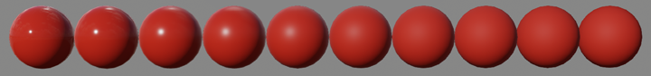
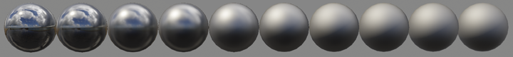
Roughness Rules Them all
The Roughness input literally controls how rough the Material is. A rough Material will scatter reflected light in more directions than a smooth Material. This can be seen in how blurry or sharp the reflection is or in how broad or tight the specular highlight is. Roughness of 0 (smooth) is a mirror reflection and roughness of 1 (rough) is completely matte or diffuse.

Slide 10
Base Color/Albedo
Base Color simply defines the overall color of the Material. It takes in a Vector3 (RGB) value and each channel is automatically clamped between 0 and 1.
If taken from the real world, this is the color when photographed using a polarizing filter (polarization removes the specular of nonmetals when aligned).
The Basec color should not contain any light information such as baked in shadows or specular highlights.

Slide 11
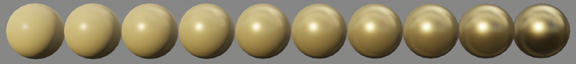
Heavy Metal Rocks!
The Metallic input literally controls how "metal-like" your surface will be. Nonmetals have Metallic values of 0, metals have Metallic values of 1. For pure surfaces, such as pure metal, pure stone, pure plastic, etc. this value will be 0 or 1, not anything in between. When creating hybrid surfaces like corroded, dusty, or rusty metals, you may find that you need some value between 0 and 1.

Slide 12
Specular, should I stay or should I go?
The Specular input should not be connected and left as its default value of 0.5 for “most” cases.
For very diffuse Materials, you may be inclined to set this to zero. Resist! All Materials have specular. What you really want to do for very diffuse Materials is make them rough.
Commonly, if we modify Specular, we do so to add micro occlusion or small scale shadowing, say from cracks represented in the normal map. These are sometimes referred to as cavities. Small scale geometry, especially details only present in the high poly and baked into the normal map, will not be picked up by the renderer's real-time shadows.

Slide 13
Ambient Occlusion Map, fake shadows
An Ambient Occlusion (AO) map creates soft shadowing, as if the model was lit without a direct light source, like on a cloudy day.
AO is usually baked from geometry because it is created using a non-realtime ray-casting lighting solution. It can either be stored in a texture, or it can be stored in the vertex colors of the model.
There are a number of programs that can assist in baking out an ambient occlusion map.
I prefer to use Knald for all of my AO Bakes

Slide 14
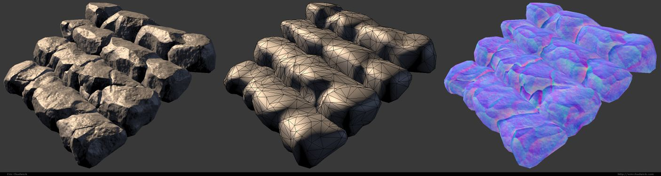
Normal Map
A normal map is an image that stores a direction at each pixel. These directions are called normal
The red, green, and blue channels of the image are used to control the direction of each pixel's normal.
A normal map is commonly used to fake high-resolution details on a low-resolution model. Each pixel of the map stores the surface slope of the original high-res mesh at that point. This creates the illusion of more surface detail or better curvature. However, the silhouette of the model doesn't change.

Slide 15
Normal Map Examples

Slide 16
High to Low Resolution Baking Workflow
Model Your High Resolution Model
Retopologize your Low Resolution Model to be a game asset
UV Mapping
Triangulate Your Low Res Model before baking
Mirror and duplicate any geometry that is the same
Separate or explode your model into separate pieces for baking
Baking your textures in Knald
Import into Sunstance Painter
Texture your model in Substance Painter
Export your textures
Final touches in Photoshop

Slide 17
High Resolution Model (HR)
First rule to High Resolution Models. You are not held to any specific software or technique to make your model.
Second Rule. As long as your model looks physically as close to the the real world model as possible then you are on the right track.
Third Rule. Reduce Fasciting as much as you can on your HR model. This means smooth transitions and curved surfaces as much as you can.
Fourth rule. Even hard surface models have rounded edges.

Slide 18
Polygon Modeling Software for HR Models
Maya, 3DS Max, Modo
Using Supporting edges to get smooth rounded surfaces
In Maya you use the 3 Hot Key Smooth Mesh Preview
In 3DS Max you use the Turbo Smooth Modifier
Using the crease tools to get soft edges when subdividing your model
Maya and 3DS Max have a crease tool that allows you to define edge hardness in smooth mesh preview and Turbo Smooth. This process has its advantages and disadvantages if not explained in detail.
3DS Max has a plugin you can buy called Turbo Smooth Pro.

Slide 19
CAD Solids Modeling Software for HR Models
Solidworks – Commonly used in product design and the manufacturing industry. Creates high res models quickly using Solids modeling techniques.
Autodesk Inventor – Autodesks competitor to Solidworks
Autodesk Fusion 360 – Cheaper Solids modeler just recently released by Autodesk for the exploding rapid prototyping industry.

Slide 20
Demo Software Stuff and Stuff
From here I will demo a gun model that I did in colaberation with my friend Elliot Lilly a Freelance Concept Designer.
Elliot’s latest design was the grenade launcher in Call of Duty Black Ops III.
Have a good concept to go from when you start your modeling process.

Slide 21
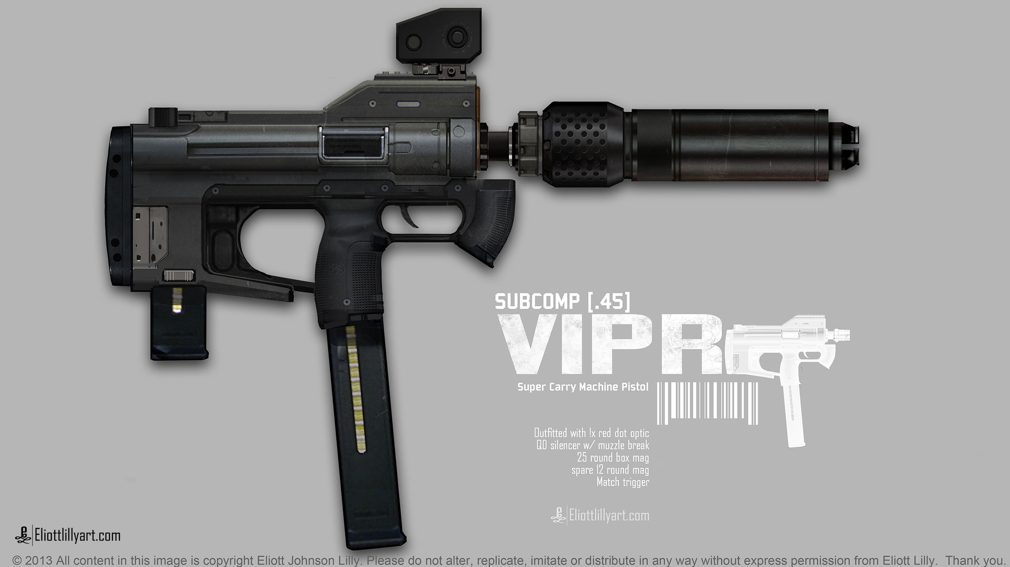
This is the concept Elliott gave me permission to model. It is important to always get permission before modeling other peoples designs.

Slide 22
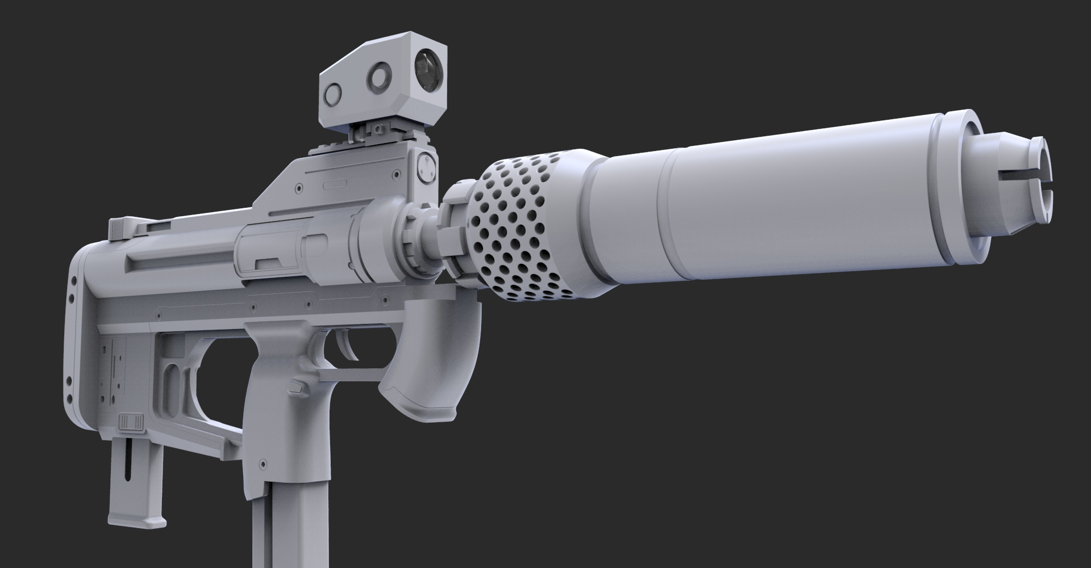
THE IMPORTANCE OF GETTING AN ACCURATE HIGH POLY MODEL
Modeled by Gregory McDonald - www.mcgergs.com

Slide 23
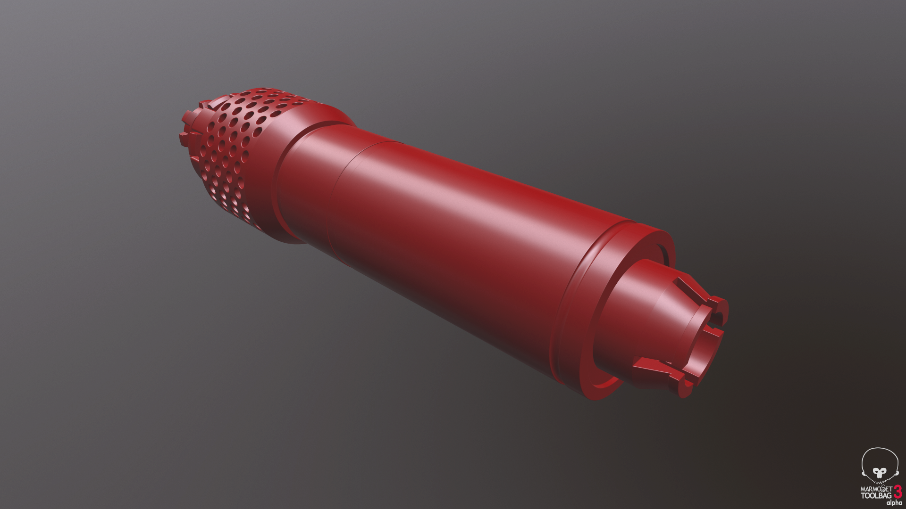
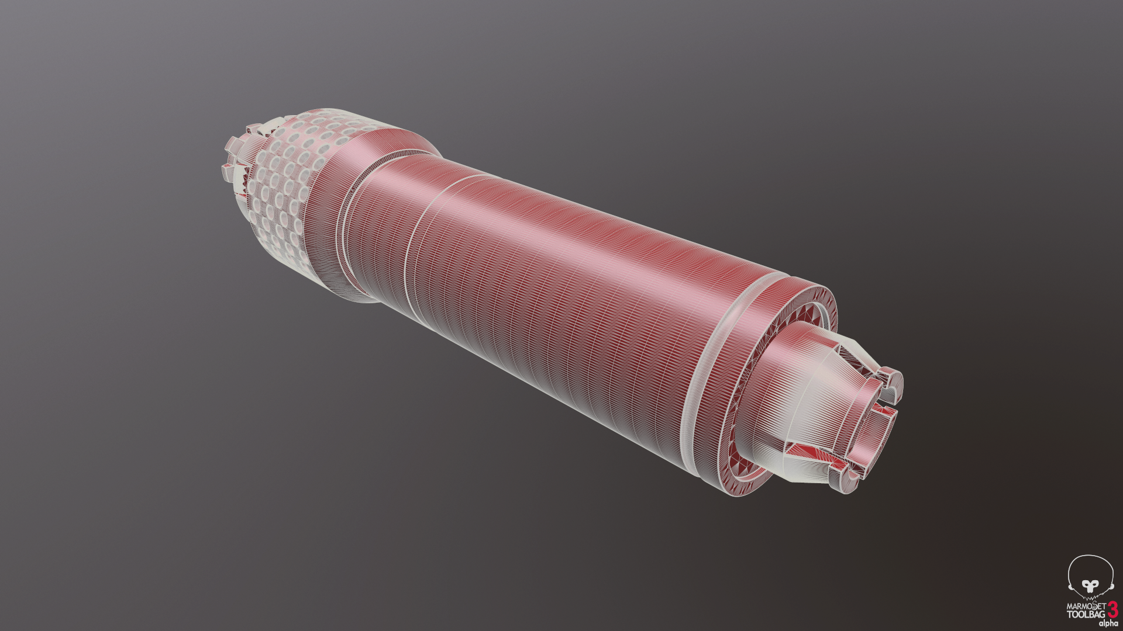
High Poly Silencer

Slide 24
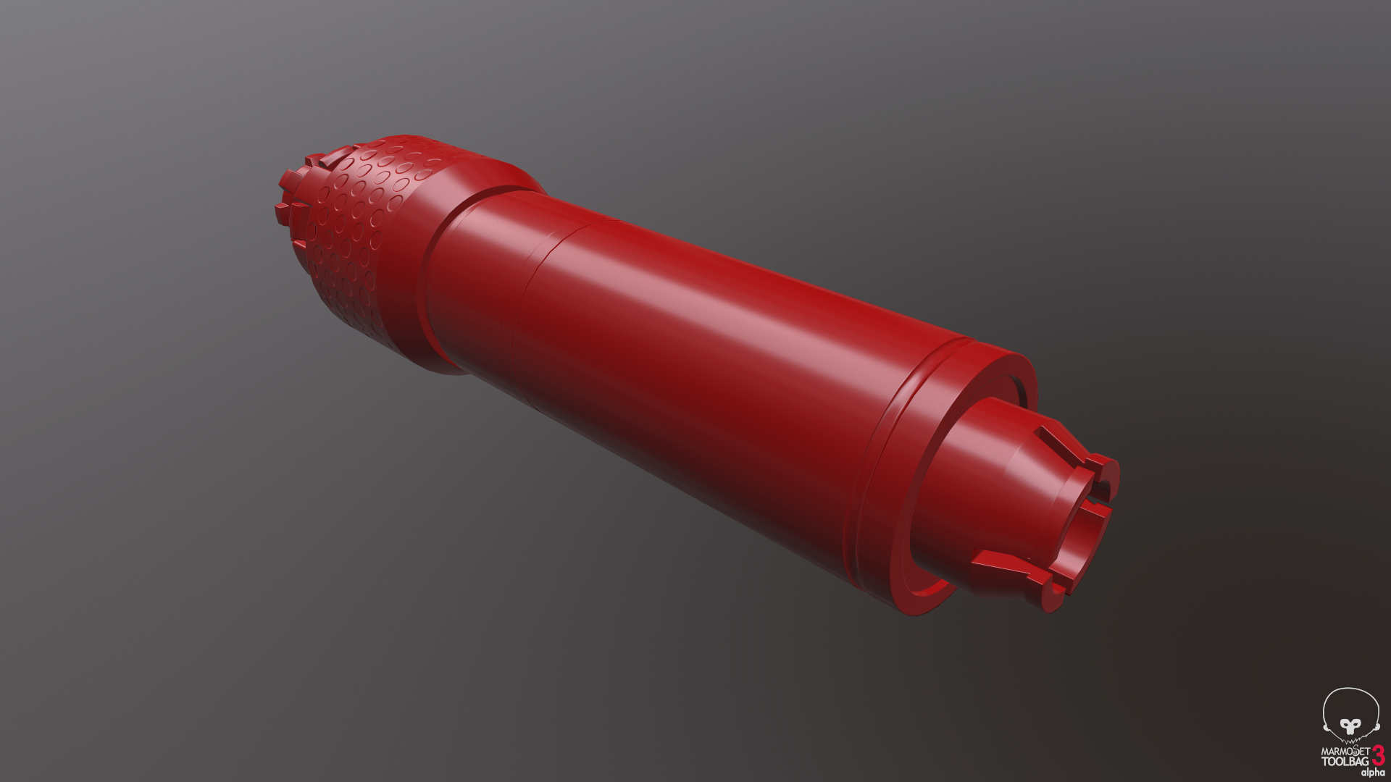

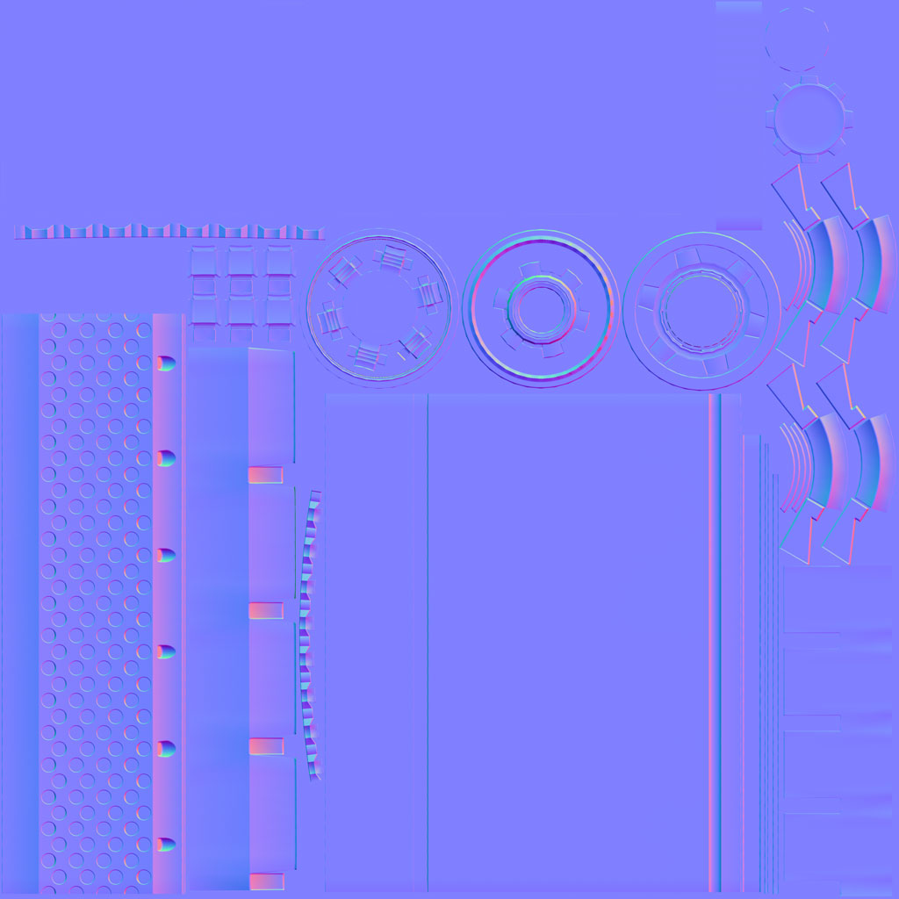
Low Poly with Tangent Normals

Slide 25
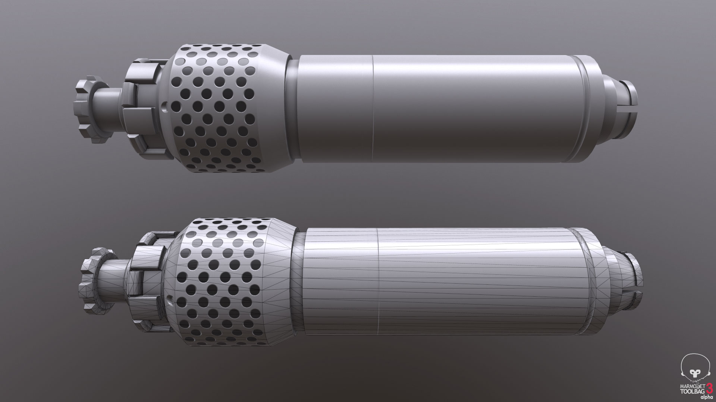
It is very important to ge the normal mapand AO correct before moving on to texturing.Or else you will have a lot of fixing to do.

Slide 26
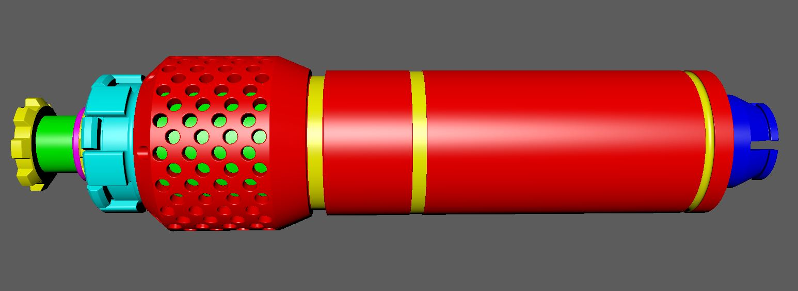
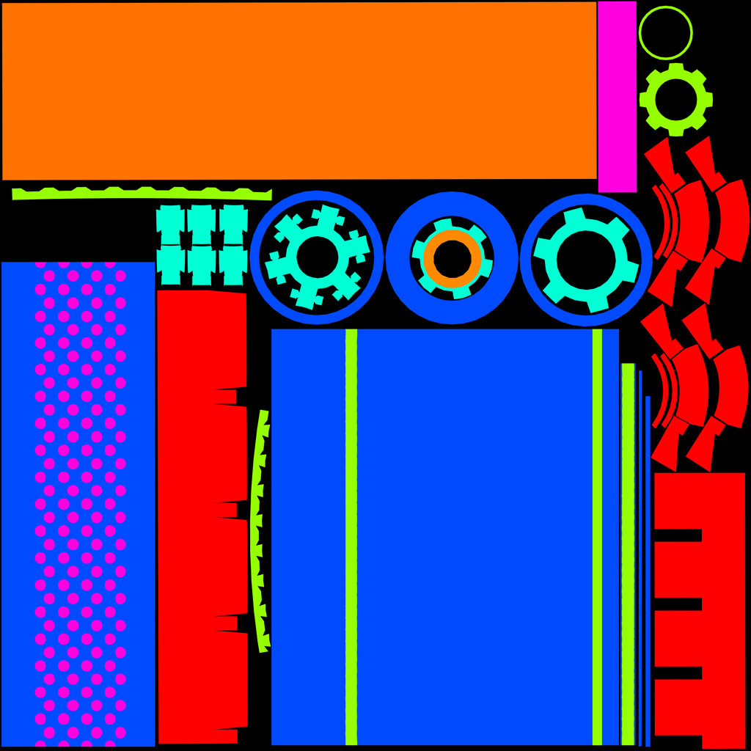
Setup Materials on your High Poly For an ID Mask. This allows for easy paint masking in Substance Painter or Quixel

Slide 27
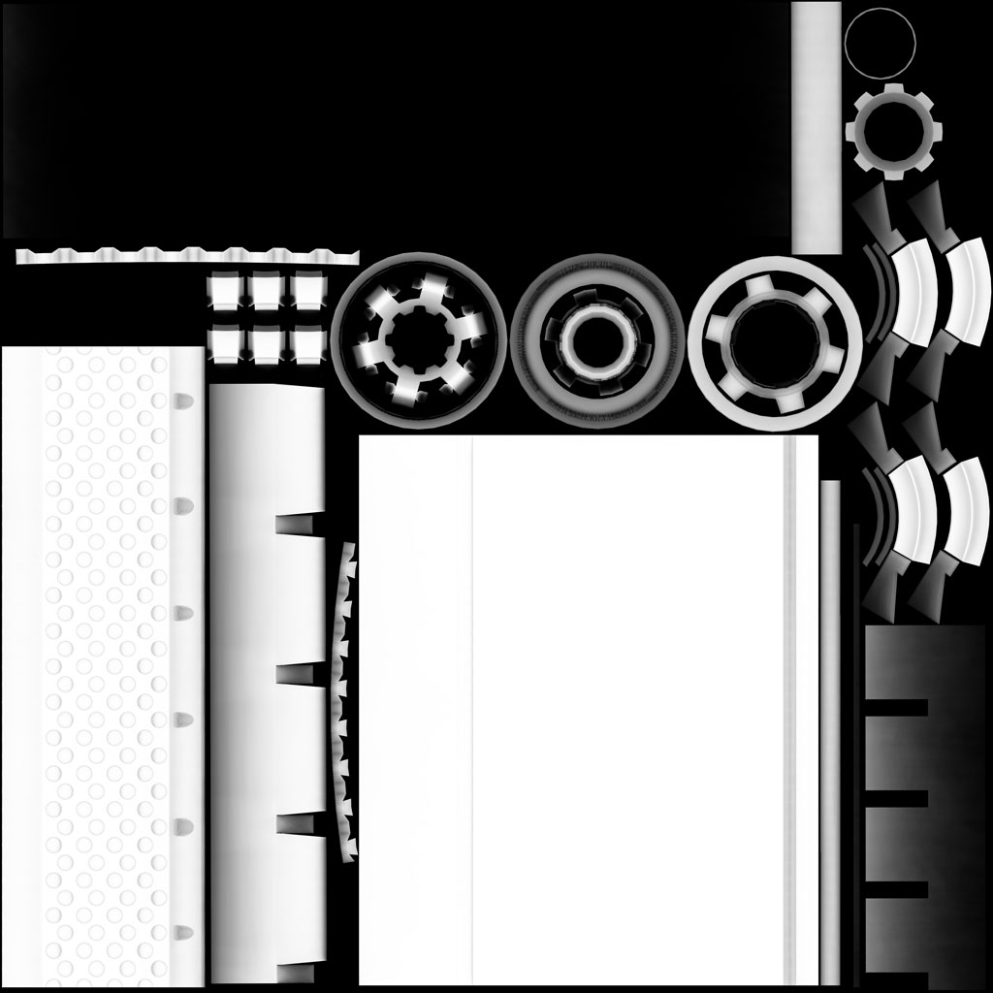
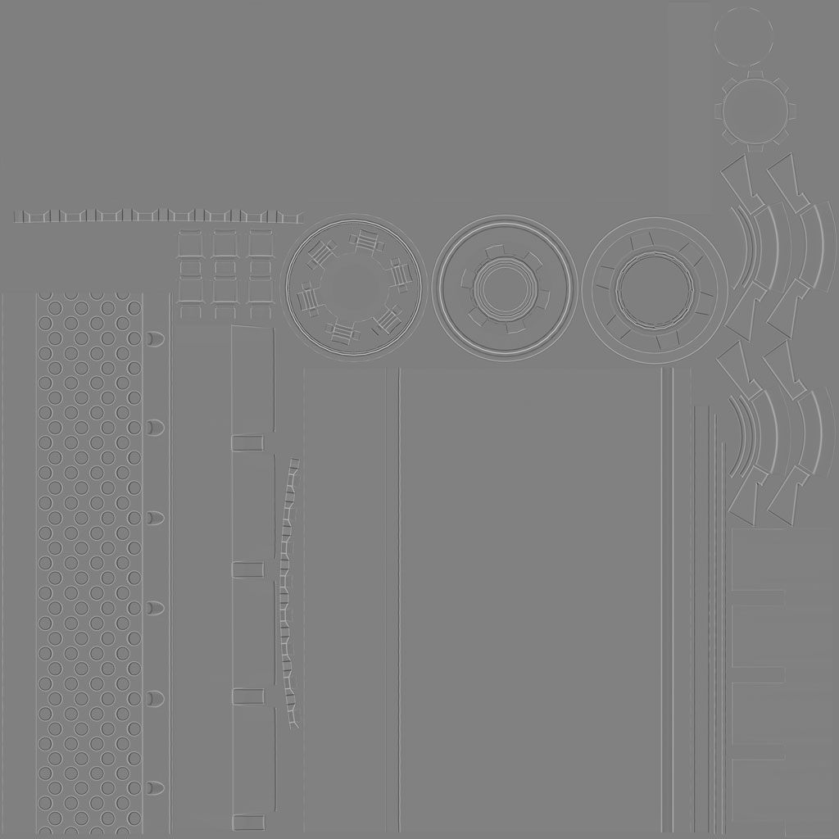
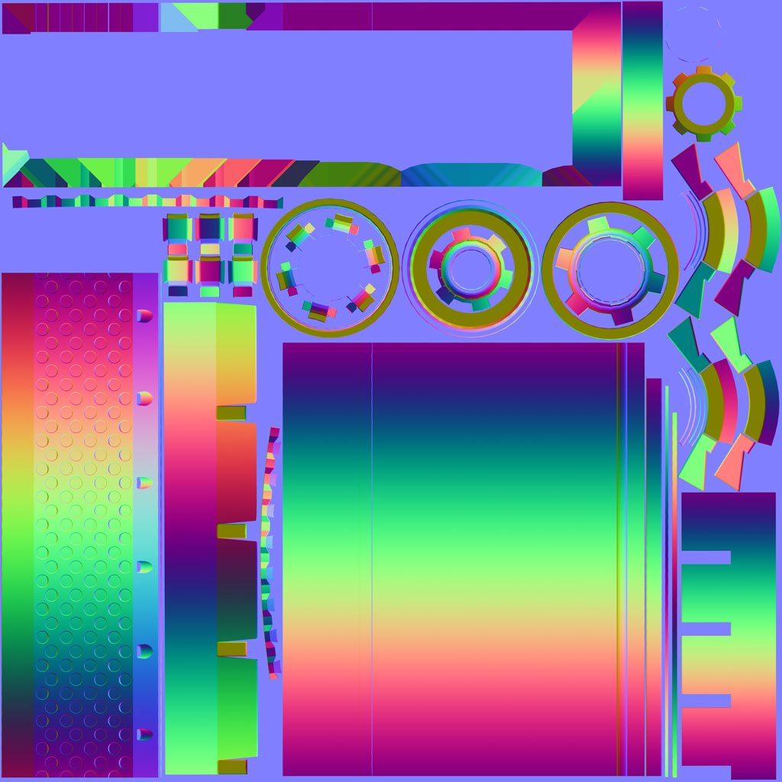
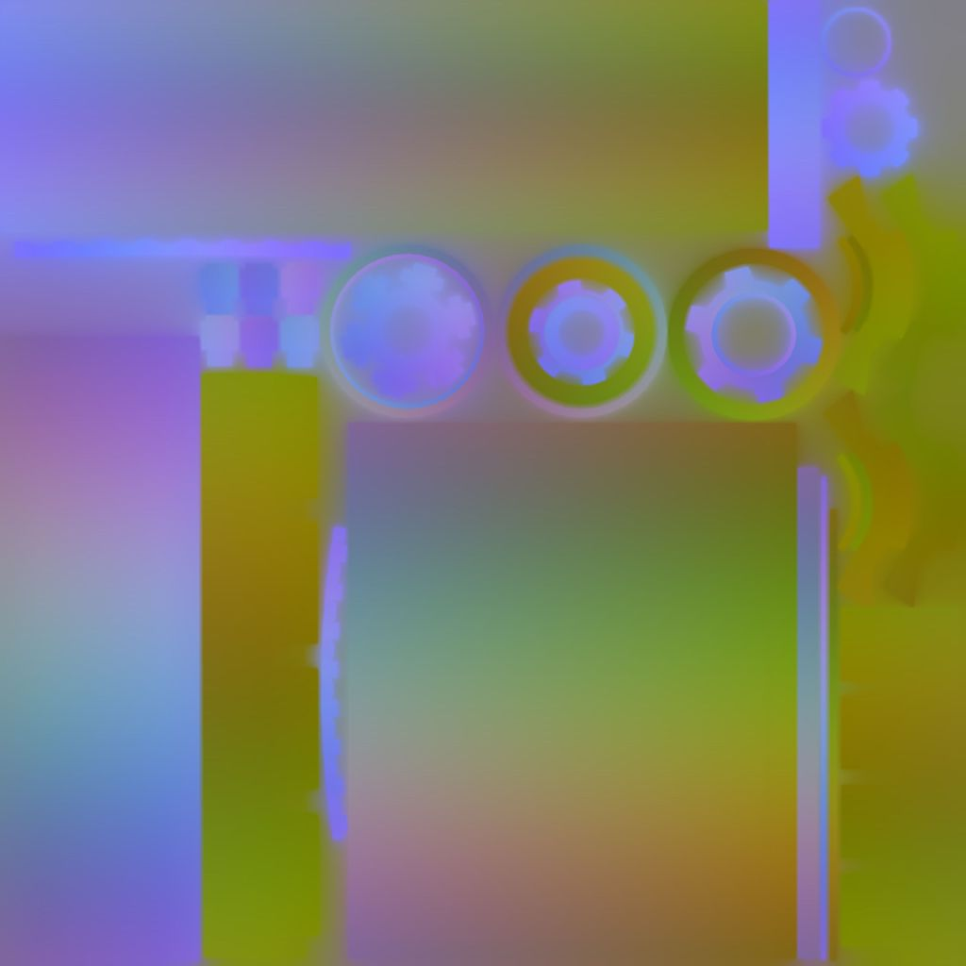
Baking Out Supporting Maps
Ambient Occlusion (AO)
Curvature
Color ID
World Space Normal
Position

Slide 28
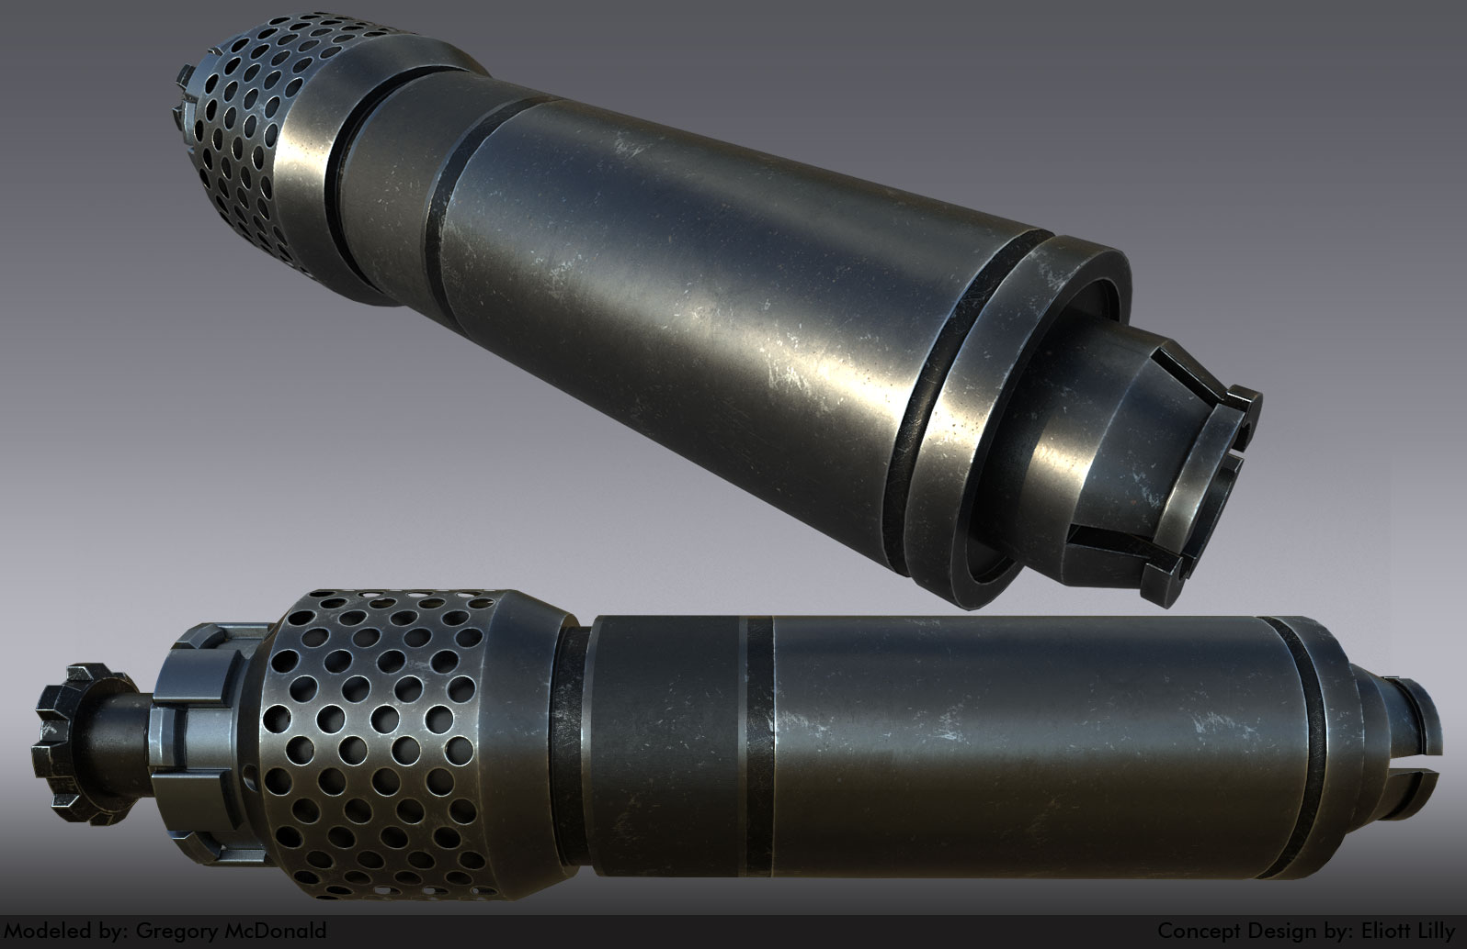
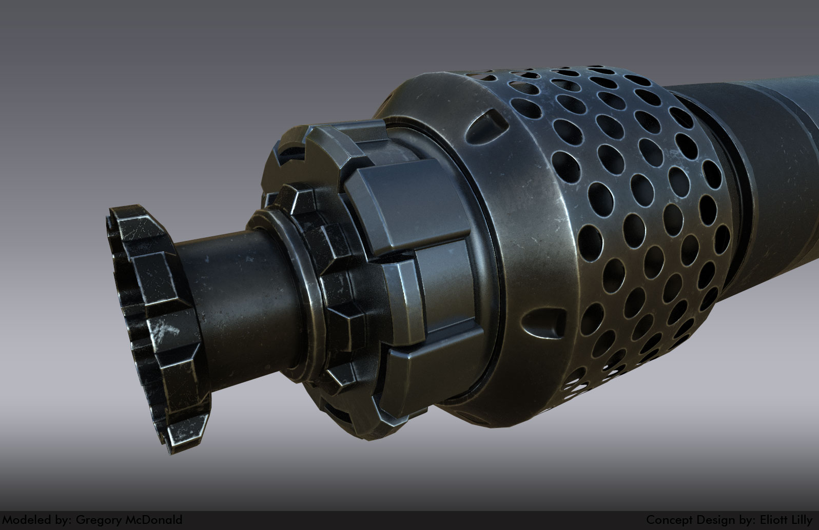
Final Substance Painter

Slide 31
Thank You For Your Time
Any Questions?

